Slide 1
BIG DATA TOOLS
Week 1

Slide 2

Instructor
Hassan Teimoori (PhD 2007, MSc 2004, MSc 2003, BSc 2000)
Part time Instructor at Sheridan College
Director, Innovation Technology
Data mining, recommendation systems, product development
Software architecture, IT security, Cloud based services, big data analytics
Data scientist
Natural Language Processing, unstructured data mining
Entrepreneurship
Post-doctoral fellow
Embedded software engineer
Contact: hassan.teimoori@sheridancollege.ca

Slide 3
Learning Objectives
Characteristics of Big Data
Identify the types of Big Data
Explain the data science process
Differentiate the Big Data Tools based on the goal and use of each

Slide 4
Big Data in a glance
Big data is a term for data sets that are so large or complex that traditional data processing application software is inadequate to deal with them.
Key enablers
Increase of storage capacities
Increase of processing power
Availability of data

Slide 5
Data Science
Data science, also known as data-driven science, is an interdisciplinary field about scientific methods, processes, and systems to extract knowledge or insights from data in various forms.
Data science and big data evolved from statistics and traditional data management but are now considered to be distinct disciplines.
Example
Internet of Things (IoT)
Banking industry
Retail industry
Challenges include:
Capture
Storage
Analysis
Data curation
Search
Sharing
Transfer
Visualization
Querying
Updating
Information privacy.

Slide 6
Characteristics of Big Data
Volume – how much data
Terabyte ➔ Zettabyte
Variety – what types of data
Structured ➔ Structured & unstructured
Velocity – what speed is new data generated
Batch ➔ Streaming data
4. Veracity – how accurate/relevant
https://www.youtube.com/watch?v=Hv397JnNWYc

Slide 7
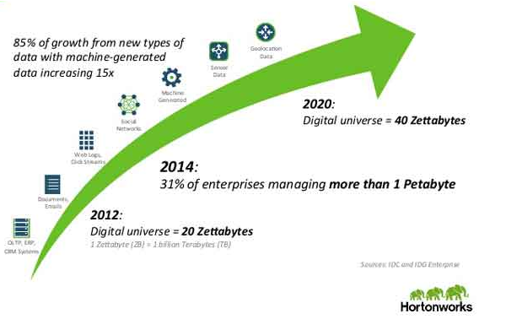
Characteristics of Big Data - Volume
https://www.youtube.com/watch?v=_KWeQxWukwo
http://imedita.com/blog/career-in-big-data-hadoop/

Slide 8
Characteristics of Big Data - Variety
Archived data
Multimedia
Social media
Public web
Data storage
Machine log data
Internet of Things (IoT)
Astronomical data
Intelligent transport systems
Mobile locations
Weather data
Healthcare data
Retail data
Email records
Telecommunication data
…
All that data diversity makes up the variety vector of big data.

Slide 9
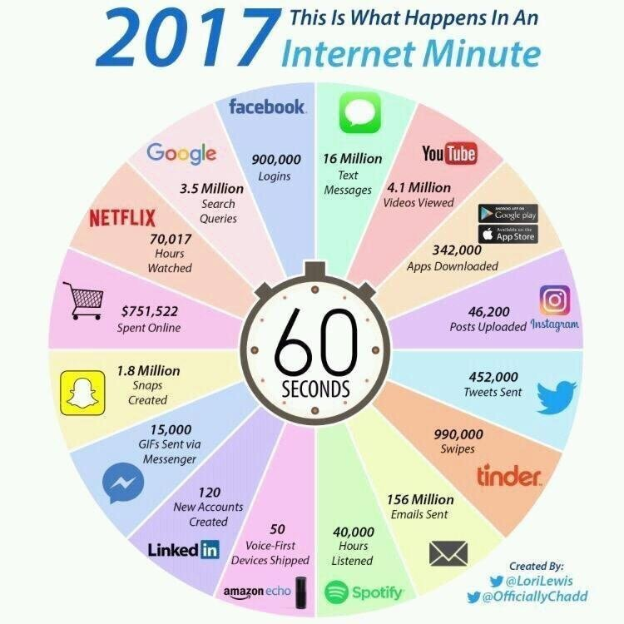
Characteristics of Big Data - Velocity
Clickstreams
Stock trading algorithms
Machine to machine process
Internet of Things
Online gaming systems
Social media
https://www.youtube.com/watch?v=mqGdVOk4K8Y

Slide 10
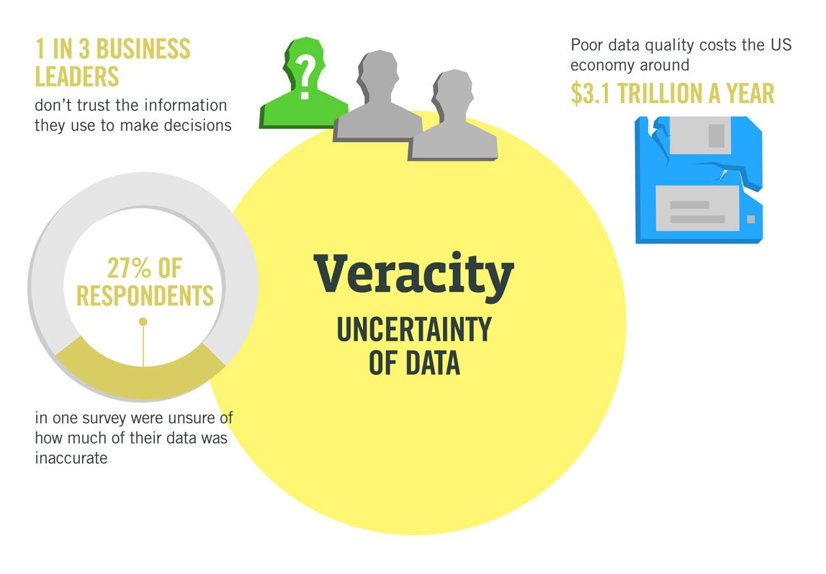
Characteristics of Big Data - Veracity
Also referring as quality or validity
Data can be full of biases, imprecise, or inaccurate.
https://www.mytechlogy.com/IT-blogs/7151/the-four-vs-of-big-data/#.WWrL4ohuJpg

Slide 11
Types of Big Data
Structured
Unstructured
Natural language
Machine-generated
Graph-based
Audio, video, and images
Streaming

Slide 12
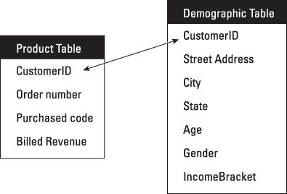
Types of Big Data -Structured
Data is organized with fixed size, so that it could be easily stored and managed within relational databases.
The data model / schema is already decided
Structured Query Language (SQL)
sometimes called relational data

Slide 13

Types of Big Data - Unstructured
Does not have any organized row-column format.
Majority of the total data in each organization.
Difficult to analyze.

Slide 14
Types of Big Data – Natural Language
Type of unstructured data
Requires knowledge of specific data science techniques and linguistics.
Ambiguous by nature
Example tasks:
entity recognition, topic recognition, summarization, text completion, and sentiment analysis

Slide 15
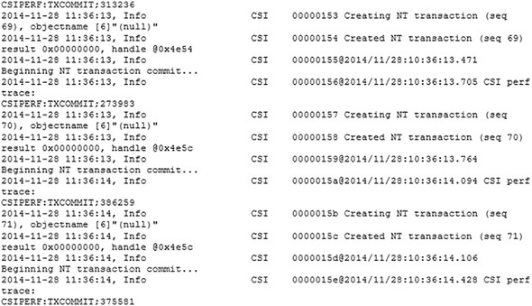
Types of Big Data – Machine-generated data
information that’s automatically created by a computer, process, application, or other machine without human intervention.
The analysis of machine data relies on highly scalable tools, due to its high volume and speed.
Boeing 737 will generate 240 terabytes of flight data during a single flight across the US

Slide 16
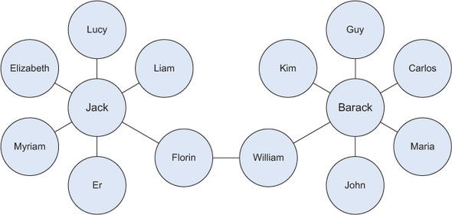
Types of Big Data – Graph-based or network data
In graph theory, a graph is a mathematical structure to model pair-wise relationships between objects.
Graph or network data is, in short, data that focuses on the relationship or adjacency of objects.
Example usage: Social Network, Semantic Web

Slide 17
Types of Big Data – Audio, image, and video
Tasks that are trivial for humans, such as recognizing objects in pictures, turn out to be challenging for computers.
Tasks that are trivial for humans, such as recognizing objects in pictures, turn out to be challenging for computers.
Example application:
Face recognition
Police and public safety

Slide 18
Types of Big Data – streamed data
The data flows into the system when an event happens instead of being loaded into a data store in a batch.
The primary difference is the issue of velocity.
Examples are the “What’s trending” on Twitter, live sporting or music events, and the stock market.

Slide 19
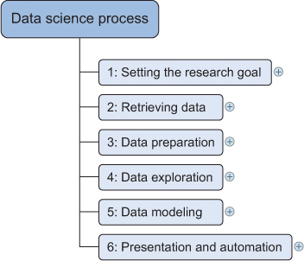
Data Science Process
The data science process typically consists of six steps
The objective is to reach to knowledge from data!
The agile project model is an alternative to a sequential process with iterations.
Attention: Garbage in equals garbage out.

Slide 20
Research Goal
What are the benefits from that
What data and resources you need
You need to be able to translate data questions into something actionable.
Success definition and how you can measure it?
Timetable and deliverables.
Notes:
Provide some examples of research goal statements, keep in mind level of the students.

Slide 21
Retrieving Data
Data may be within company resource or externally available and in any format.
Data repositories:
databases ➔ data storage
data marts ➔ serving a specific business unit
data warehouse ➔ reading and analyzing that data
data lakes ➔ contains data in its natural or raw format
Getting access to the data may take time and involve company politics.

Slide 22
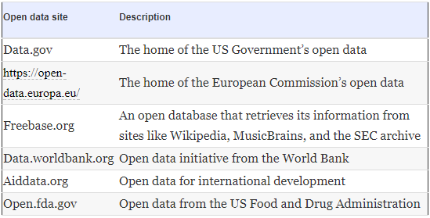
Retrieving Data
Table 2.1. A list of open-data providers that should get you started
Notes:
Ask: where would you find data?
Ask: what is a Chinese Wall?

Slide 23
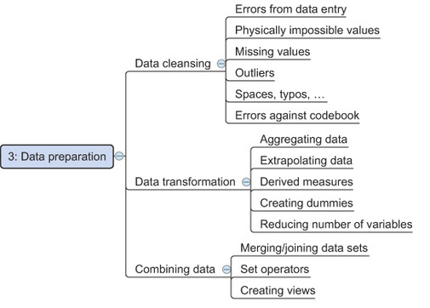
Data Preparation
Manipulation of data into a form suitable for further analysis and processing.
Cleansing
Correct Errors
Combine data from different sources
Transform data
60%-80% of the time spent on a data mining project!

Slide 24
Data Exploration
Building a deeper understanding of your data.
How variables interact with each other, the distribution of the data, and whether there are outliers.
typically involves summarizing the main characteristics of a dataset.
To achieve this you mainly use descriptive statistics, visual techniques, and simple modeling.

Slide 25
Data Modelling
Based on the research goal,
May lead to developing predictive or descriptive models.
Leverage multiple machine learning or statistical algorithms
It is a highly iterative process in terms of development, evaluation, test, adjustment and deployment.

Slide 26
Presentation and Automation
This stage is to harvest the effort and present the result to the business.
In real work problem, the presentation of data is happening frequently which merit automation and different presentation format

Slide 27
Big Data Tools
The big data ecosystem can be grouped into technologies that have similar goals and functionalities.
Type of Tool | Tool
Retrieving and Storing Data | Hadoop, HIVE, PIG NoSQL
Data Preparation | Python
Data Exploration | MongoDB Spark

Slide 28
Activity: exploring Big data Ecosystem
Top big data Tools
https://www.predictiveanalyticstoday.com/what-is-big-data-and-top-bigdata-tools/
https://www.youtube.com/watch?v=2xATbcBvtqU
https://www.youtube.com/watch?v=0lH706jQ8GQ

Slide 29
Skill requirements for Big Data engineer
Programming: Python, R, Java, big data tools (Hadoop, spark,…)
Quantitative Skills for earning foundation in data analytics (covered in the other courses in Data Science program in Sheridan college)
Keep eye open on technology trends and new tools and facilities
Be aware of business and domain
Soft skills: creativity, ingenuity, and curiosity
http://www.carriermanagement.com/features/2017/08/30/170429.htm

